Slide 1
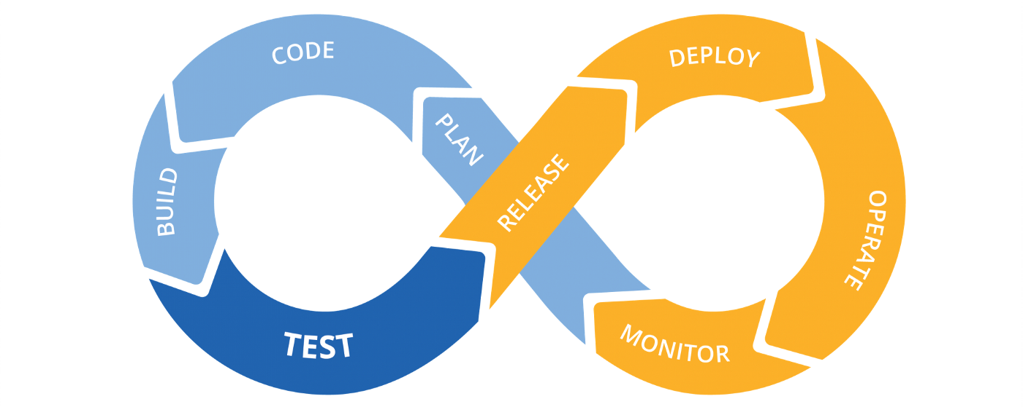
Final project
EPAM DevOps online Winter 2022

Slide 2
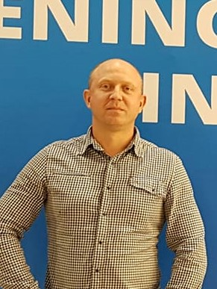
Vitaly Morozov

Slide 3
Used tools
GitHub is a web-based hosting service for version control using Git.
Jenkins is an open source automation server.
Terraform is an open source “Infrastructure as Code” tool.
AWS is a secure cloud services platform, offering compute power, database storage, content delivery and other functionality to help businesses scale and grow.
Docker is a set of platform as a service (PaaS) products that use OS-level virtualization to deliver software in packages called containers.

Slide 4
Project Steps
«Push» HTML-page(and other files) on GitHub
Create Terraform file for deploying infrastructure on AWS. There are 2 instances. (1 – JenkinsServer, install Docker, run container from standard image jenkins, 2 – webserver, install Apache)
Configure Jenkins for CI\CD
Commit on GitHub and check result on Apache Server

Slide 5
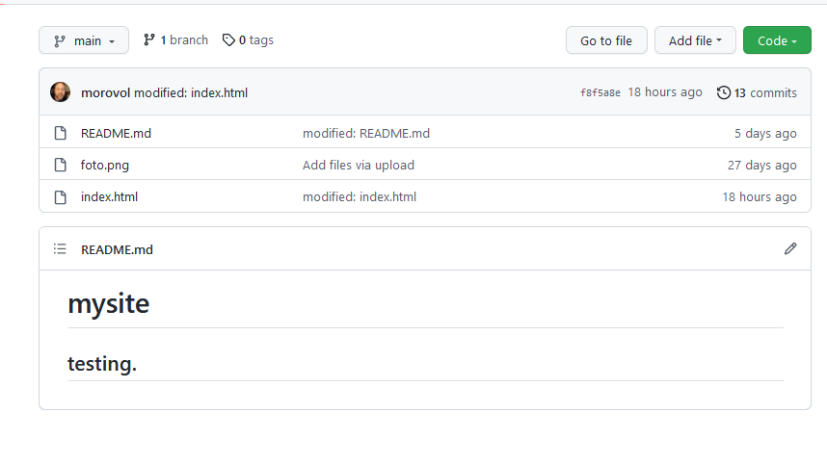
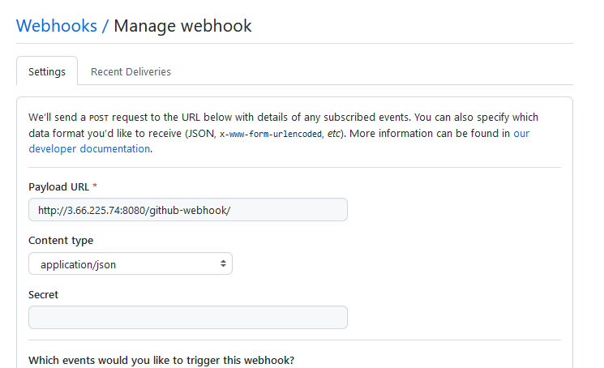
GitHub
Webhook for jenkins

Slide 6
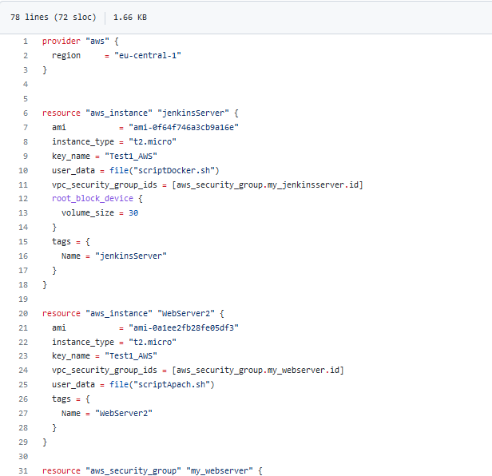
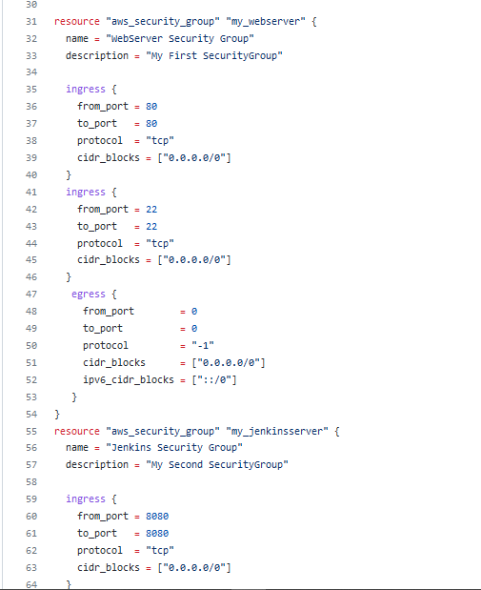
Terraform

Slide 7
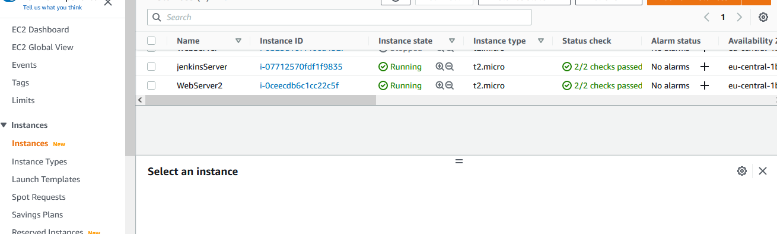
AWS

Slide 8
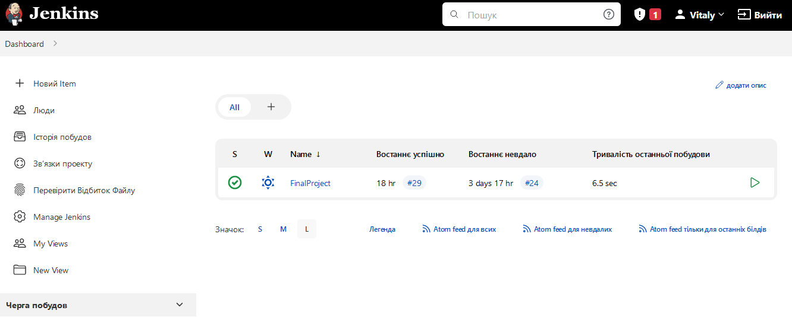
Jenkins

Slide 9
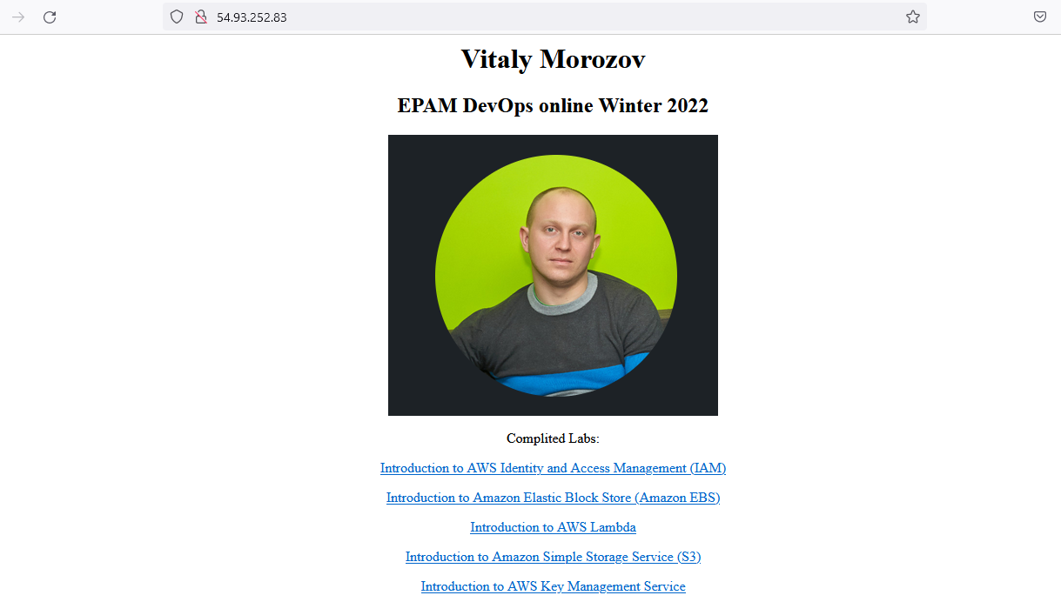
Web site

